Slide 1
INTRODUCTION TO
Session
on
SPSS
Instructor:
Md. Safayet Hossain
Lecturer,
Department of Statistics
Comilla University

Slide 2
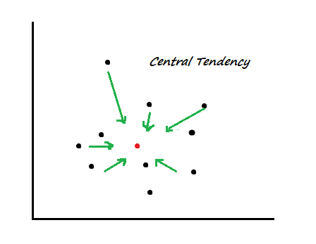
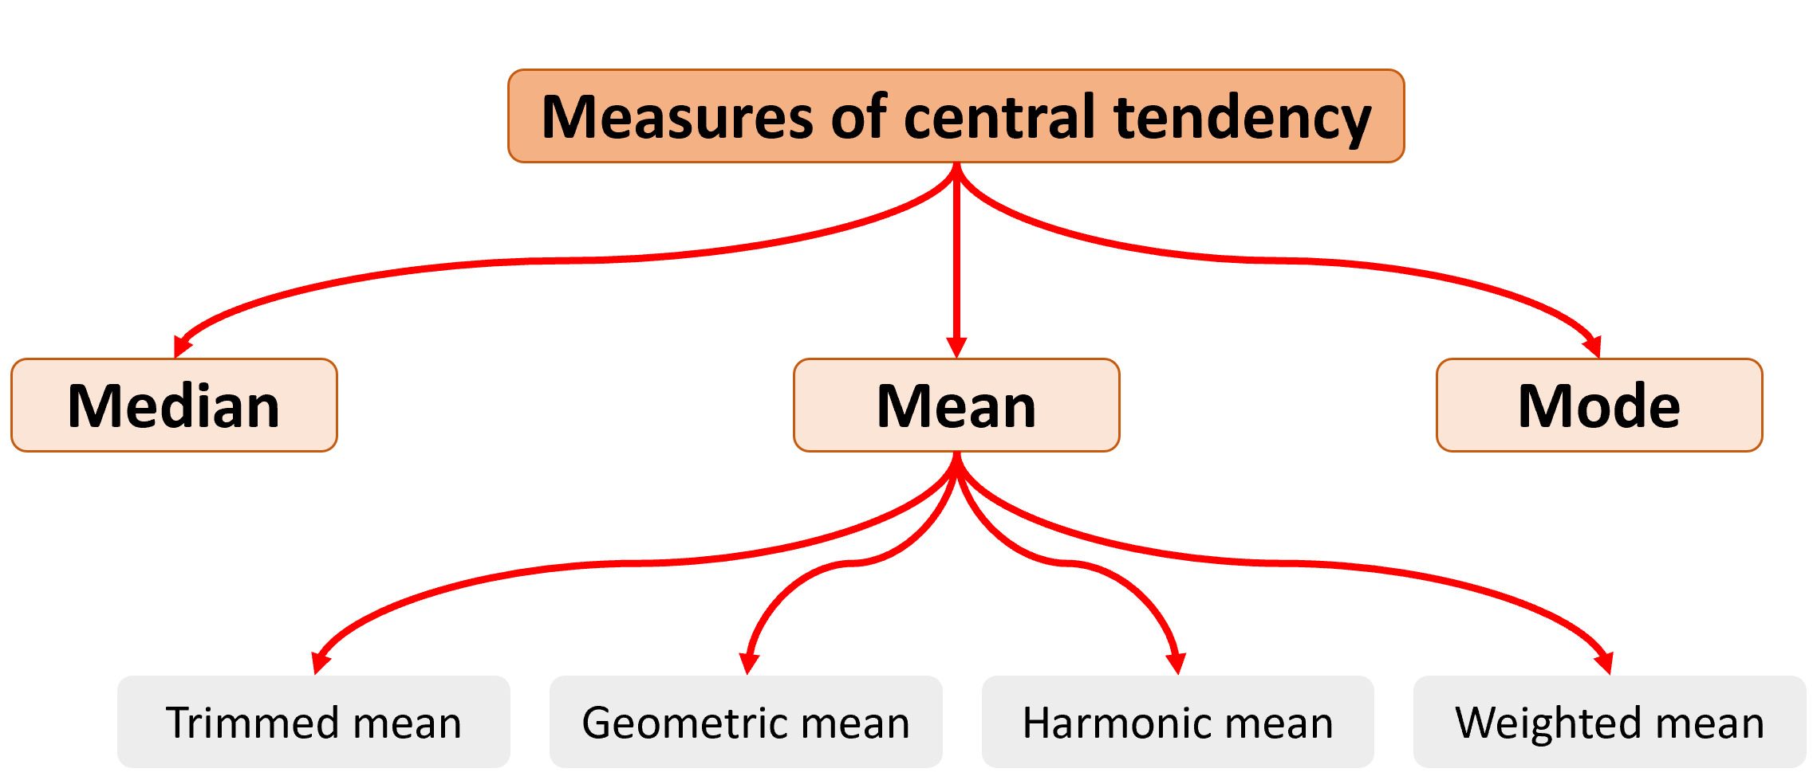
Central Tendency
Central tendency: Central tendency is a statistical concept that describes the central or typical value of a dataset, around which all other observations tend to cluster

Slide 3
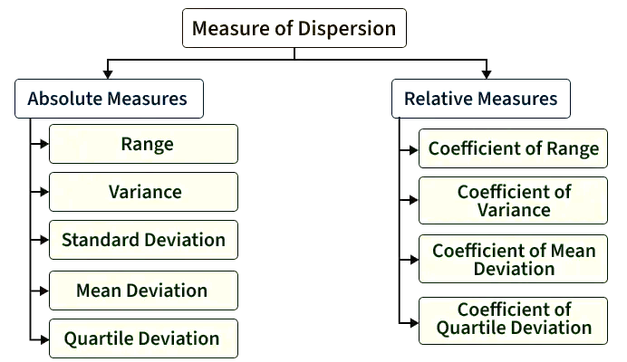
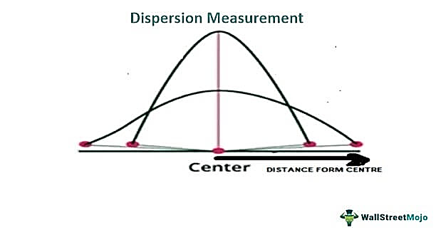
Dispersion
Measures of dispersion: Measures of dispersion describe the spread or variability of data values around a central value (mean, median, or mode). They show how scattered or consistent the data is.
Absolute measures: Absolute measures show the actual amount of variation in the same unit as the data. They express dispersion in original units (kg, years, income, etc.)
Relative measures: Relative measures show the proportional or percentage variation relative to the central value. They are unit-free (standardized)

Slide 4
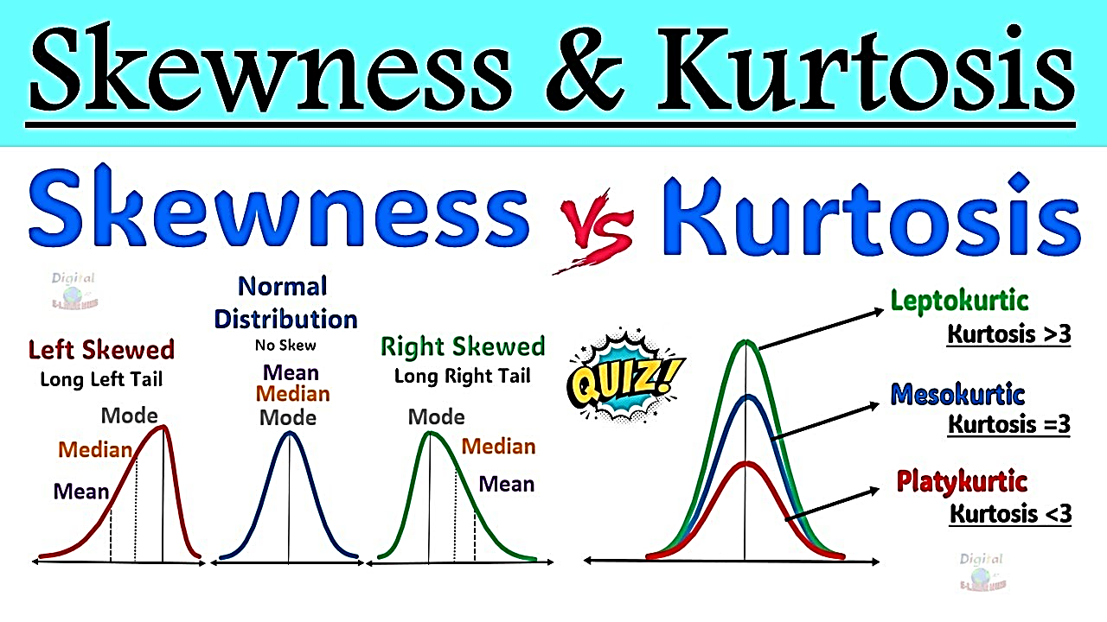
Skeness and Kurtosis
Skewness: Skewness is a statistical measure that describes the degree and direction of asymmetry in a data distribution around its mean.
Kurtosis: Kurtosis is a statistical measure that indicates the shape of a distribution, particularly its peakedness and heaviness of tails compared to a normal distribution.
Kurtosis = 3 → Normal distribution (Mesokurtic)
Kurtosis > 3 → More peaked, heavier tails (Leptokurtic)
Kurtosis < 3 → Flatter peak, lighter tails (Platykurtic)
Measures asymmetry of data distribution
Skewness = 0 → perfectly symmetric
Positive skew → tail extends right
Negative skew → tail extends left
Why Important?
Checks normality assumptions
Useful before regression or parametric tests
Helps identify outliers/extreme values

Slide 5
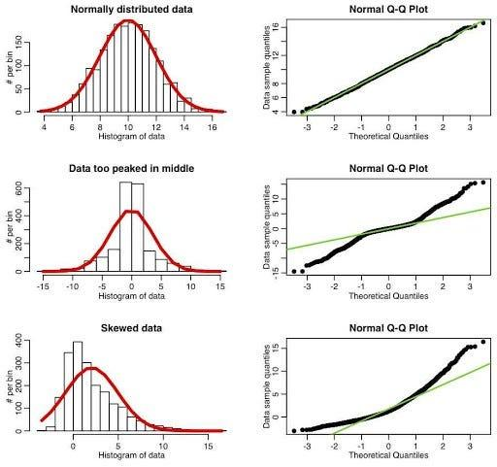
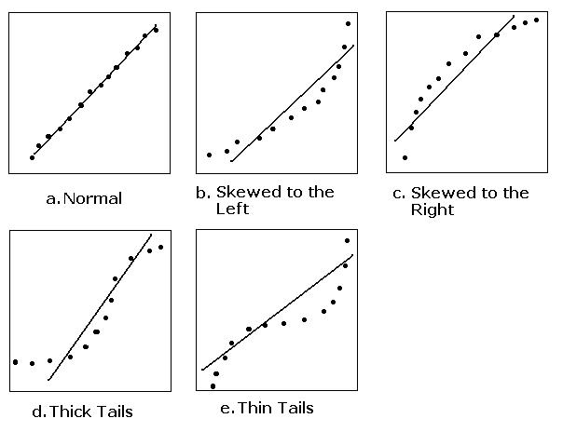
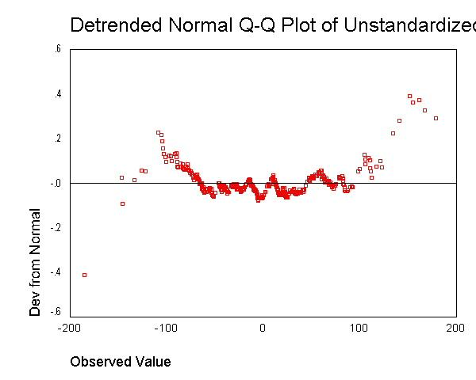
Normality check

Slide 6
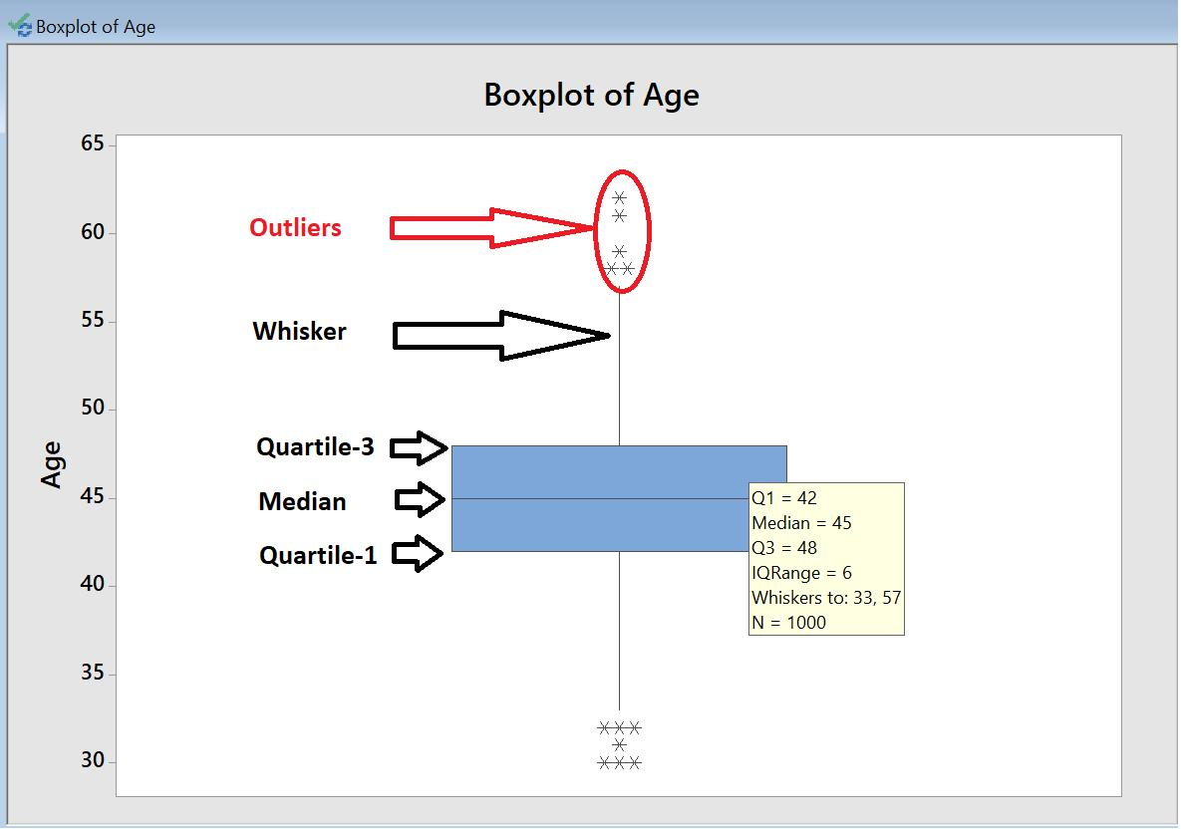
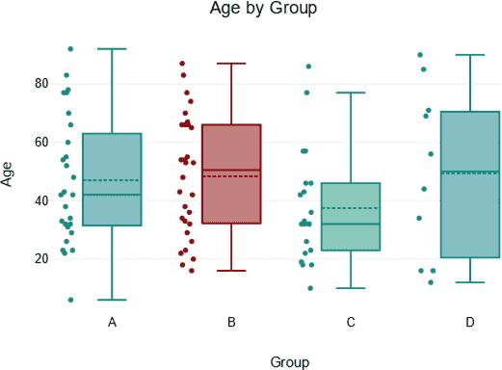
Outlier detection

